Slide 1

问题求解与实践
——GUI编程（1）
主讲教师： 陈雨亭、沈艳艳

Slide 2
Chapter 12
A display model
Bjarne Stroustrup
www.stroustrup.com/Programming

Slide 3
Abstract
This lecture presents a display model (the output part of a GUI), giving examples of use and fundamental notions such as screen coordinates, lines, and color. Some examples of shapes are Lines, Polygons, Axes, and Text.
Stroustrup/Programming

Slide 4
Overview
Why graphics?
A graphics model
Examples
Stroustrup/Programming

Slide 5
Why bother with graphics and GUI?
It’s very common
  If you write conventional PC applications, you’ll have to do it
It’s useful
  Instant feedback
  Graphing functions
  Displaying results
It can illustrate some generally useful concepts and techniques
Stroustrup/Programming

Slide 6
Why bother with graphics and GUI?
It can only be done well using some pretty neat language features ☺
Lots of good (small) code examples
It can be non-trivial to “get” the key concepts
  So it’s worth teaching
  If we don’t show how it’s done, you might think it was “magic”
Graphics is fun!
Stroustrup/Programming

Slide 7
Why Graphics/GUI?
WYSIWYG
  What you see (in your code) is what you get (on your screen)
Direct correspondence between concepts, code, and output
Stroustrup/Programming

Slide 8
Display model
Shape
Display
Engine
attach()
draw()
“window”
Square
attach()
Objects (such as graphs) are “attached to” a window.
The “display engine” invokes display commands
(such as “draw line from x to y”) for the objects in a window
Objects such as Square contain vectors of lines, text, etc. for the window to draw
Stroustrup/Programming

Slide 9
Display model
An example illustrating the display model
  int main()
  {
  using namespace Graph_lib; // use our graphics interface library
  Point tl(100,200); // a point (obviously)
  Simple_window win(tl,600,400,"Canvas"); // make a simple window
  Polygon poly; // make a shape (a polygon, obviously)
  poly.add(Point(300,200)); // add three points to the polygon
  poly.add(Point(350,100));
  poly.add(Point(400,200));
  poly.set_color(Color::red); // make the polygon red (obviously)
  win.attach(poly); // connect poly to the window
  win.wait_for_button(); // give control to the display engine
  }
Stroustrup/Programming

Slide 10
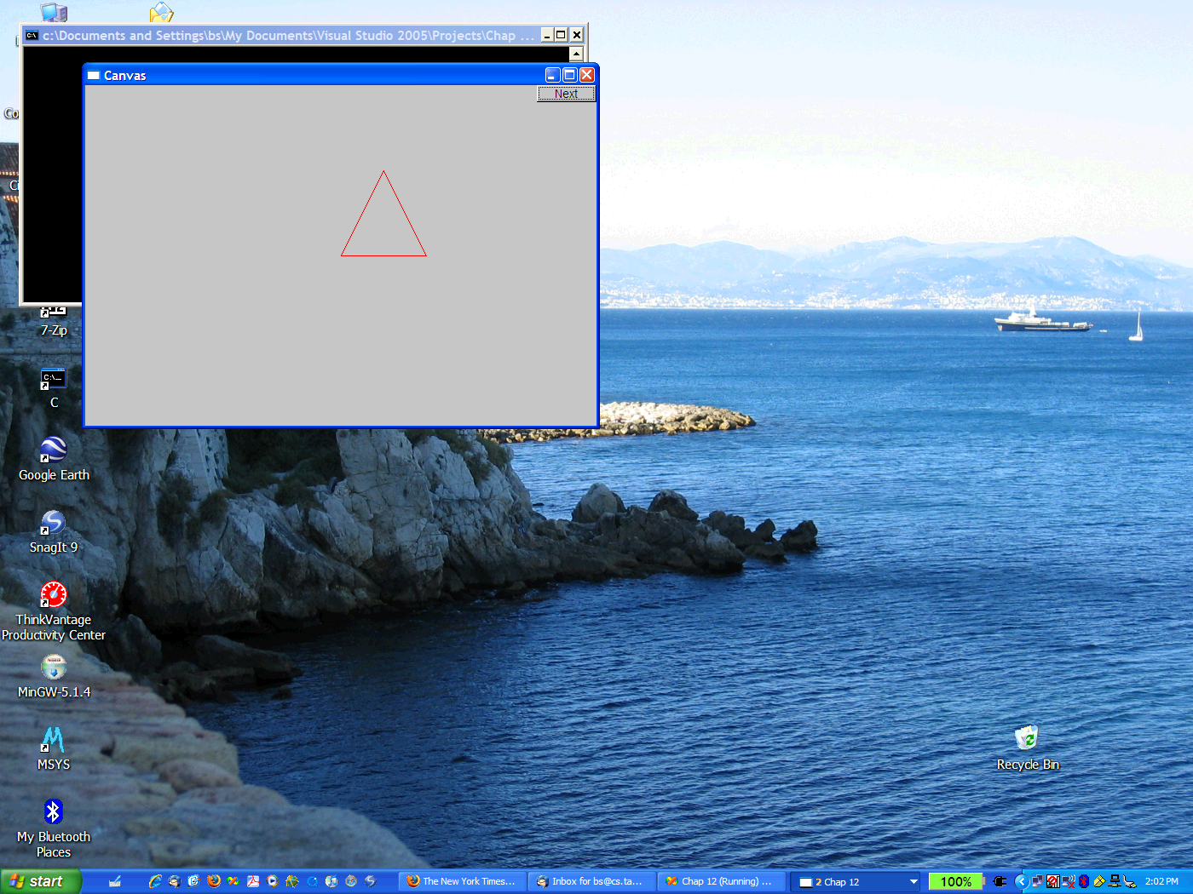
The resulting screen
Stroustrup/Programming

Slide 11
Graphics/GUI libraries
You’ll be using a few interface classes we wrote
  Interfacing to a popular GUI toolkit
    GUI == Graphical User Interface
    FLTK: www.fltk.org // Fast Light Tool Kit
  Installation, etc.
    See piazza.com, Appendix D and ask instructor/friend
      FLTK
      Our GUI and graphics classes
      Project settings
This model is far simpler than common toolkit interfaces
  The FLTK (very terse) documentation is 370 pages
  Our interface library is <20 classes and <500 lines of code
  You can write a lot of code with these classes
    And you can build more classes on them
Stroustrup/Programming

Slide 12
Graphics/GUI libraries (cont.)
The code is portable
  Windows, Unix, Mac, etc.
This model extends to most common graphics and GUI uses
The general ideas can be used with any popular GUI toolkit
  Once you understand the graphics classes you can easily learn any GUI/graphics library
    Well, relatively easily – these libraries are huge
Stroustrup/Programming

Slide 13
Graphics/GUI libraries
Our code
Our interface library
A graphics/GUI library (here FLTK)
The operating system (e.g. Windows or Linux)
Our screen
Often called “a layered architecture”
Stroustrup/Programming

Slide 14
Coordinates
0,0
199,0
50,50
0,99
199,99
Oddly, y-coordinates “grow downwards” // right, down
Coordinates identify pixels in the window on the screen
You can resize a window (changing x_max() and y_max())
Stroustrup/Programming

Slide 15
Interface classes
Line_style
Window
Color
Shape
Point
Simple_window
Line
Lines
Polygon
…
Rectangle
Text
An arrow means “is a kind of”
Color, Line_style, and Point are “utility classes” used by the other classes
Window is our interface to the GUI library (which is our interface to the screen)
Stroustrup/Programming

Slide 16
Interface classes
Current
  Color, Line_style, Font, Point,
  Window, Simple_window
  Shape, Text, Polygon, Line, Lines, Rectangle, …
  Axis
Easy to add (for some definition of “easy”)
  Grid, Block_chart, Pie_chart, etc.
Later, GUI
  Button, In_box, Out_box, …
Stroustrup/Programming

Slide 17
Demo code 1
// Getting access to the graphics system (don’t forget to install):
#include "Simple_window.h" // stuff to deal with your system’s windows
#include "Graph.h" // graphical shapes
using namespace Graph_lib; // make names available
// in main():
Simple_window win(Point(100,100),600,400,"Canvas");
// screen coordinate (100,100) is top left corner of window
// window size(600 pixels wide by 400 pixels high)
// title: Canvas
win.wait_for_button(); // Display!
Stroustrup/Programming

Slide 18

A “blank canvas”
Stroustrup/Programming

Slide 19
Demo code 2
  Axis xa(Axis::x, Point(20,300), 280, 10, "x axis");
  // make an Axis
  // an axis is a kind of Shape
  // Axis::x means horizontal
  // starting at (20,300)
  // 280 pixels long
  // 10 “notches” (“tick marks”)
  // text “x axis”
  win.set_label("Canvas #2");
  win.attach(xa); // attach axis xa to the window
  win.wait_for_button();
Stroustrup/Programming

Slide 20
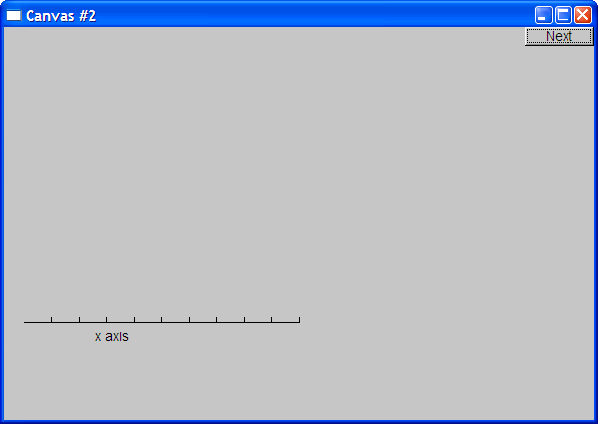
Add an X-axis
Stroustrup/Programming

Slide 21
Demo code 3
  win.set_label("Canvas #3");
  Axis ya(Axis::y, Point(20,300), 280, 10, "y axis");
  ya.set_color(Color::cyan); // choose a color for the axis
  ya.label.set_color(Color::dark_red); // choose a color for the text
  win.attach(ya);
  win.wait_for_button();
Stroustrup/Programming

Slide 22
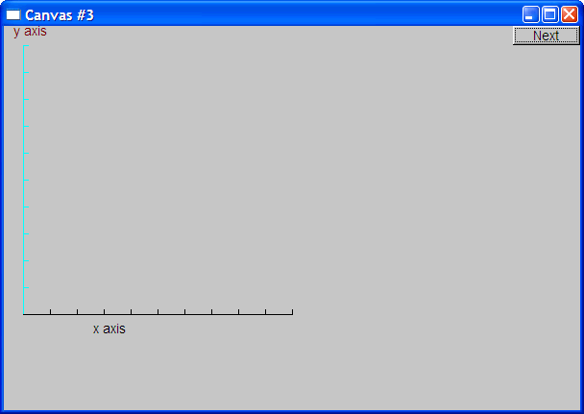
Add a Y-axis (colored)
Yes, it’s ugly, but this is a programming course, not a graphics design course
Stroustrup/Programming

Slide 23
Demo code 4
win.set_label("Canvas #4");
Function sine(sin,0,100,Point(20,150),1000,50,50); // sine curve
// plot sin() in the range [0:100)
// with (0,0) at (20,150)
// using 1000 points
// scale x values *50, scale y values *50
win.attach(sine);
win.wait_for_button();
Stroustrup/Programming

Slide 24
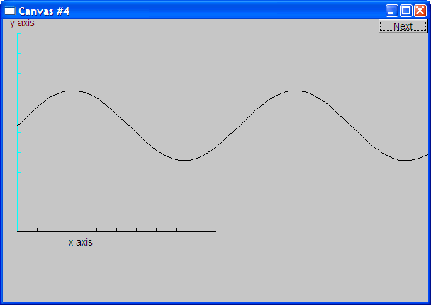
Add a sine curve
Stroustrup/Programming

Slide 25
Demo code 5
win.set_label("Canvas #5");
sine.set_color(Color::blue); // I changed my mind about sine’s color
Polygon poly; // make a polygon (a kind of Shape)
poly.add(Point(300,200)); // three points make a triangle
poly.add(Point(350,100));
poly.add(Point(400,200));
poly.set_color(Color::red); // change the color
poly.set_style(Line_style::dash); // change the line style
win.attach(poly);
win.wait_for_button();
Stroustrup/Programming

Slide 26
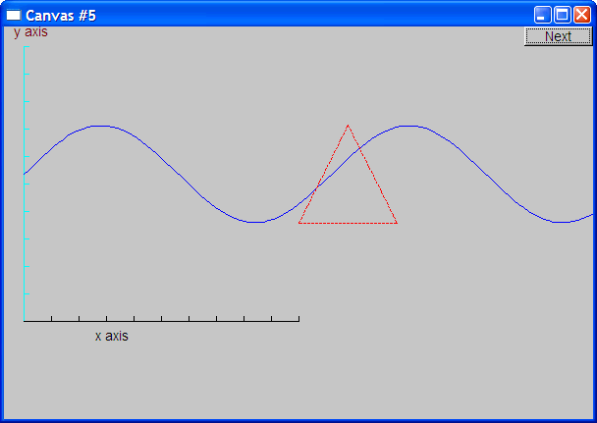
Add a triangle (and color the curve)
Stroustrup/Programming

Slide 27
Demo code 6
win.set_label("Canvas #6");
Rectangle r(Point(200,200), 100, 50); // top left point, width, height
win.attach(r);
win.wait_for_button();
Stroustrup/Programming

Slide 28
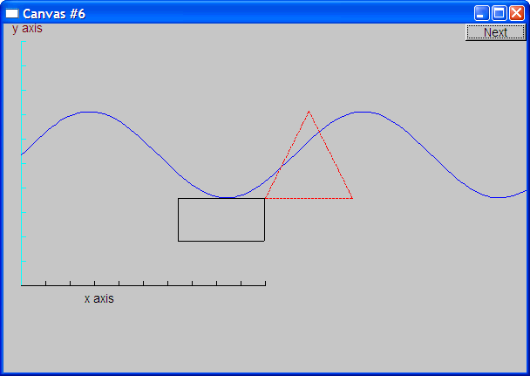
Add a rectangle
Stroustrup/Programming

Slide 29
Demo code 6.1
Add a shape that looks like a rectangle
  Closed_polyline poly_rect;
  poly_rect.add(Point(100,50));
  poly_rect.add(Point(200,50));
  poly_rect.add(Point(200,100));
  poly_rect.add(Point(100,100));
  win.set_label("Canvas #6.1");
Stroustrup/Programming

Slide 30
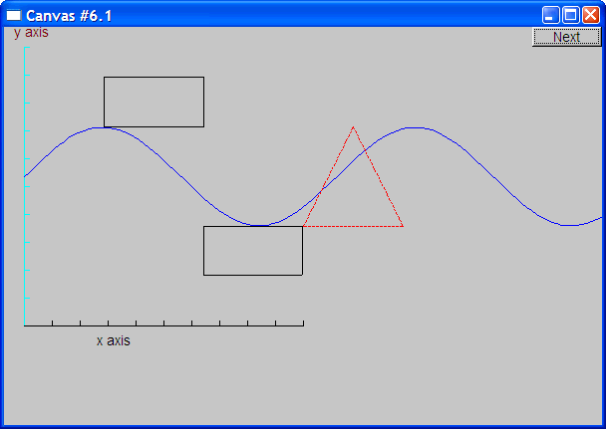
Add a shape that looks like a rectangle
But is it a rectangle?
Stroustrup/Programming

Slide 31
Demo code 6.2
We can add a point
  poly_rect.add(Point(50,75); // now poly_rect has 5 points
  win.set_label("Canvas #6.2");
“looking like” is not the same as “is”
Stroustrup/Programming

Slide 32
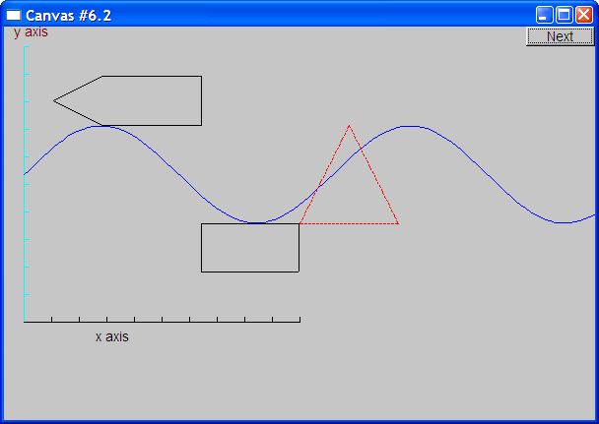
Obviously a polygon
Stroustrup/Programming

Slide 33
Add fill
  r.set_fill_color(Color::yellow); // color the inside of the rectangle
  poly.set_style(Line_style(Line_style::dash,4)); // make the triangle fat
  poly_rect.set_fill_color(Color::green);
  poly_rect.set_style(Line_style(Line_style::dash,2));
  win.set_label("Canvas #7");
Stroustrup/Programming

Slide 34
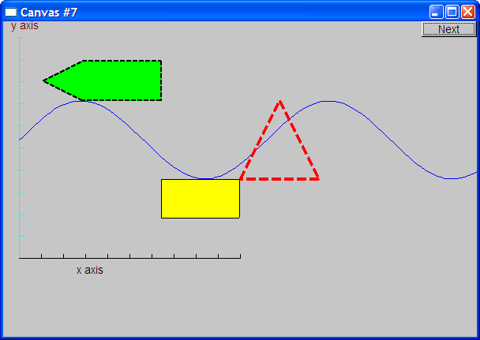
Add fill
Stroustrup/Programming

Slide 35
Demo Code 8
Text t(Point(100,100),"Hello, graphical world!"); // add text
// point is lower left corner on the baseline
win.set_label("Canvas #8");
Stroustrup/Programming

Slide 36

Add text
Stroustrup/Programming

Slide 37
Demo Code 9
Modify text font and size
  t.set_font(Font::times_bold);
  t.set_font_size(20); // height in pixels
Stroustrup/Programming

Slide 38
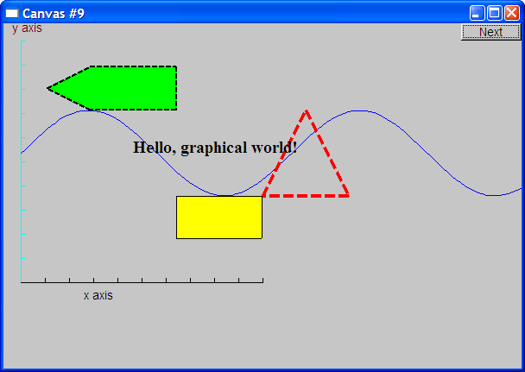
Text font and size
Stroustrup/Programming

Slide 39
Add an image
Image ii(Point(100,50),"image.jpg"); // open an image file
win.attach(ii);
win.set_label("Canvas #10");
Stroustrup/Programming

Slide 40
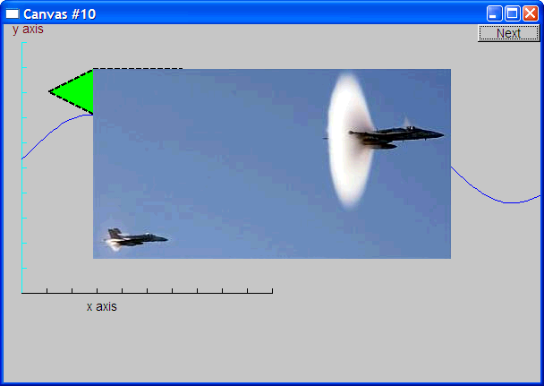
Add an image
Stroustrup/Programming

Slide 41
Oops!
The image obscures the other shapes
  Move it a bit out of the way
ii.move(100,200); // move 100 pixels to the right (-100 moves left)
// move 200 pixels down (-200 moves up)
win.set_label("Canvas #11");
win.wait_for_button();
Stroustrup/Programming

Slide 42
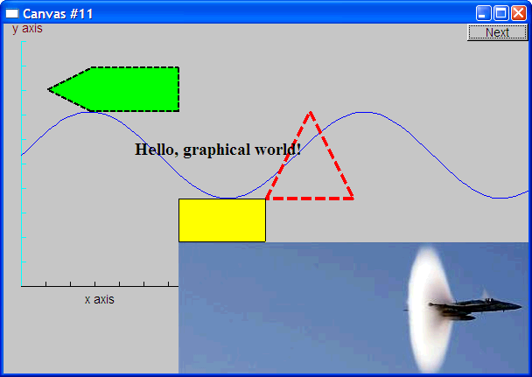
Move the image
Note how the parts of a shape that don’t fit in the window are “clipped” away
Stroustrup/Programming

Slide 43
Demo Code 12
Circle c(Point(100,200),50); // center, radius
Ellipse e(Point(100,200), 75,25); // center, horizontal radius, vertical radius
e.set_color(Color::dark_red);
Mark m(Point(100,200),'x');
ostringstream oss;
oss << "screen size: " << x_max() << "*" << y_max()
<< "; window size: " << win.x_max() << "*" << win.y_max();
Text sizes(Point(100,20),oss.str());
Image cal(Point(225,225), "snow_cpp.gif"); // 320*240 pixel gif
cal.set_mask(Point(40,40),200,150); // display center of image
win.set_label("Canvas #12");
win.wait_for_button();
Stroustrup/Programming

Slide 44
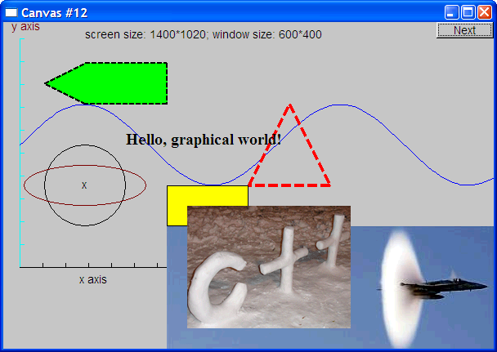
Add shapes, more text
Stroustrup/Programming

Slide 45
Boiler plate
#include "Graph.h" // header for graphs
#include “Simple_window.h" // header containing window interface
int main ()
try
{
// the main part of your code
}
catch(exception& e) {
cerr << "exception: " << e.what() << '\n';
return 1;
}
catch (...) {
cerr << "Some exception\n";
return 2;
}
Stroustrup/Programming

Slide 46
Primitives and algorithms
The demo shows the use of library primitives
  Just the primitives
  Just the use
Typically what we display is the result of
  an algorithm
  reading data
Next lectures
  13: Graphics Classes
  14: Graphics Class Design
  15: Graphing Functions and Data
  16: Graphical User Interfaces
Stroustrup/Programming

